Slide 1

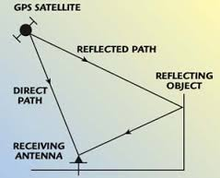
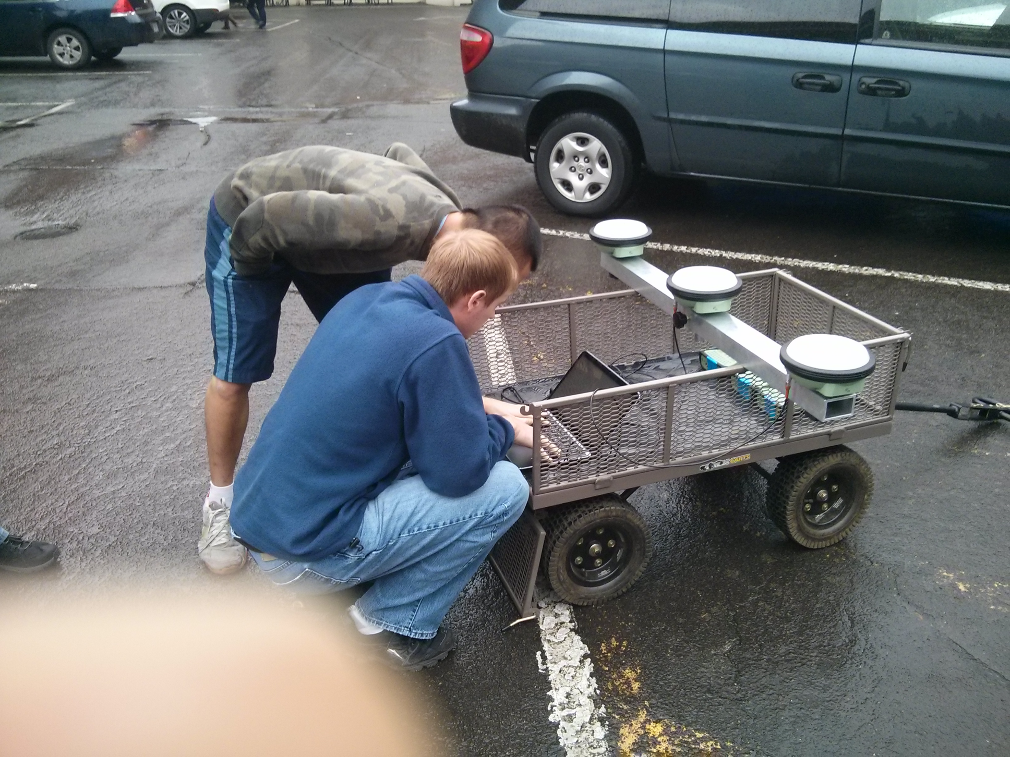
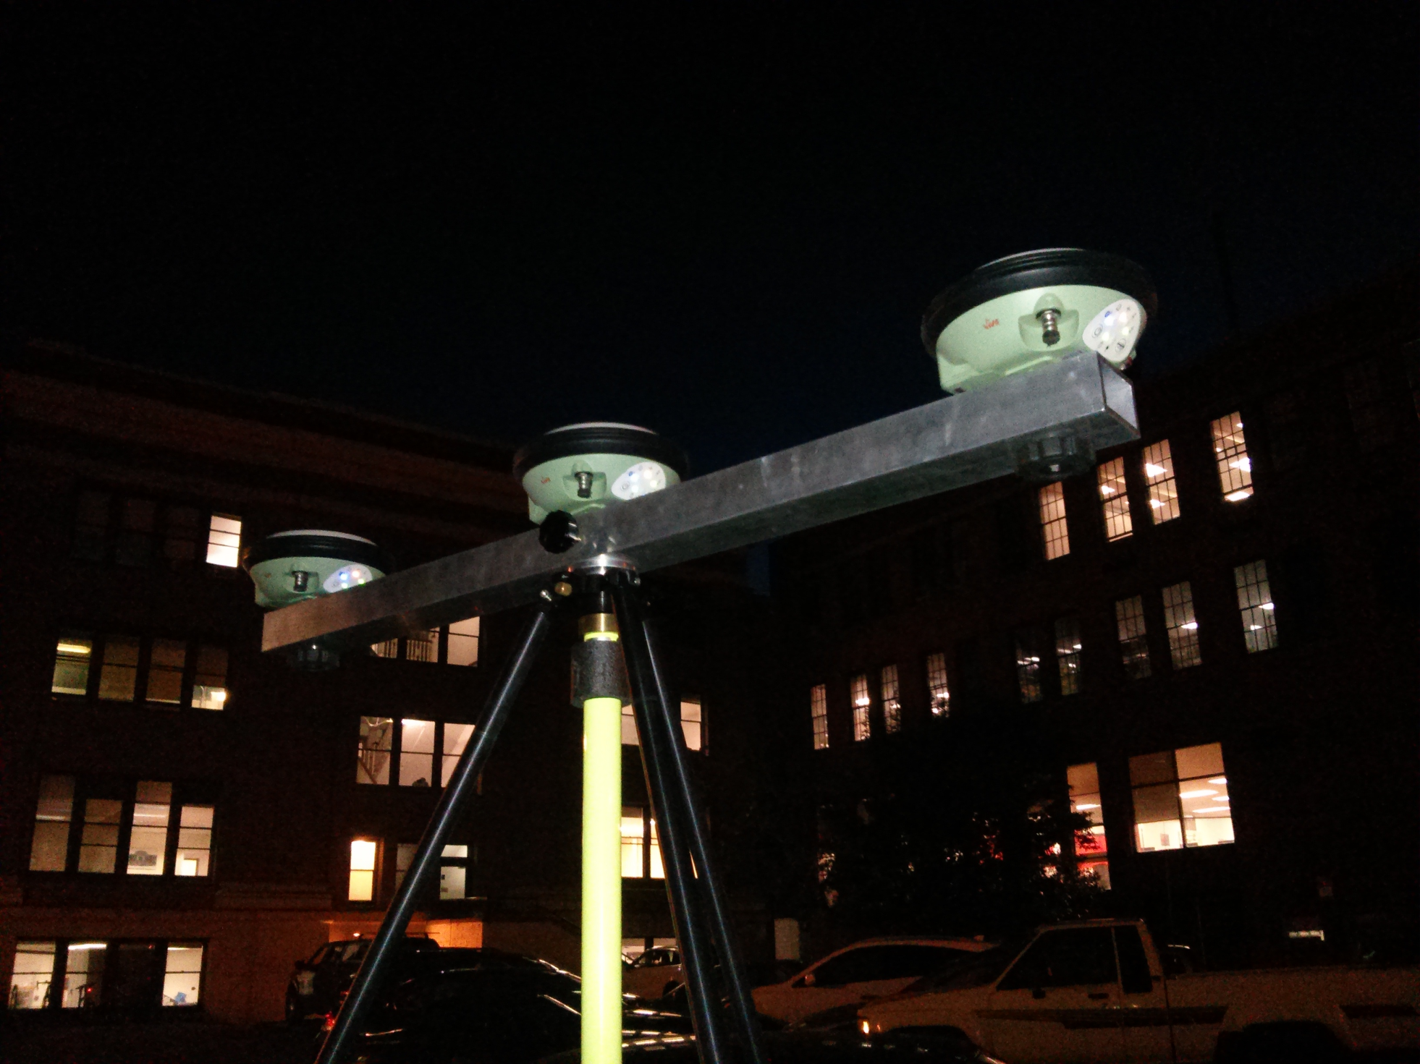
Oregon State University, College of Engineering
The Trident GPS System
Albert Le, Nathan Christopher, Daniel Lin Tzu
Head 1 Head 1 Head 1
Head 1 Head 1 Head 1
Head 1 Head 1 Head 1
Bullet
Bullet
Bullet
Bullet
Head 1 Head 1 Head 1
Bullet
Bullet
Bullet
Bullet
Bullet
Head 3 Head 3, to label the table below
Head 1 Head 1 Head 1
Head 2 Head 2 (list of References)
Head 3 head 3
Head 3 Head 3, to label the table below
Head 3 Head 3, to label the table below

